Slide 1
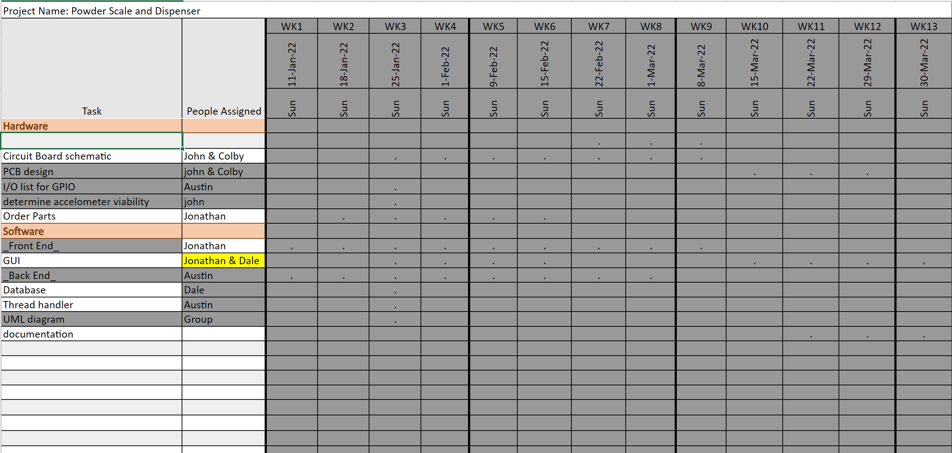
Gantt Chart

Slide 2
Week 13 (30-Mar to 5-Apr) Austin
Goal/Task | % Done | Hours (Act.)
Hours on task during the week (On track ≥ 13 / wk)
Total hours on task so far this semester (On track ≥ 163 hrs)

Slide 3
Progress made during the week (Log)
(What I did)
For example: Resources found (links, manuals), Designs created, Decisions made and corresponding rational, Photos of prototype progress, etc.

Slide 4
Difficulties encountered during the week
(What I did not do and why)
.

Slide 5
Goals for this coming week
(Ones that move the project forward the most)
Goal/Task | Stop Date (Est.) | Hours (Est.)
Estimated time needed to work on goals for this coming week (typ. 13 hrs)

Slide 6
How can we help you achieve your goals?
.

Slide 7
Week 13 (30-Mar to 5-Apr) Jonathan Phillips
Goal/Task | % Done | Hours (Act.)
Front end - Documentation | N/A | 13
Front end – Fixed <,> buttons | 100 | 2
Front end - Testing | N/A | 3
Presentation | 100 | 0.5
Hours on task during the week (On track ≥ 13 / wk) | 18.5
Total hours on task so far this semester (On track ≥ 163 hrs) | 153

Slide 8
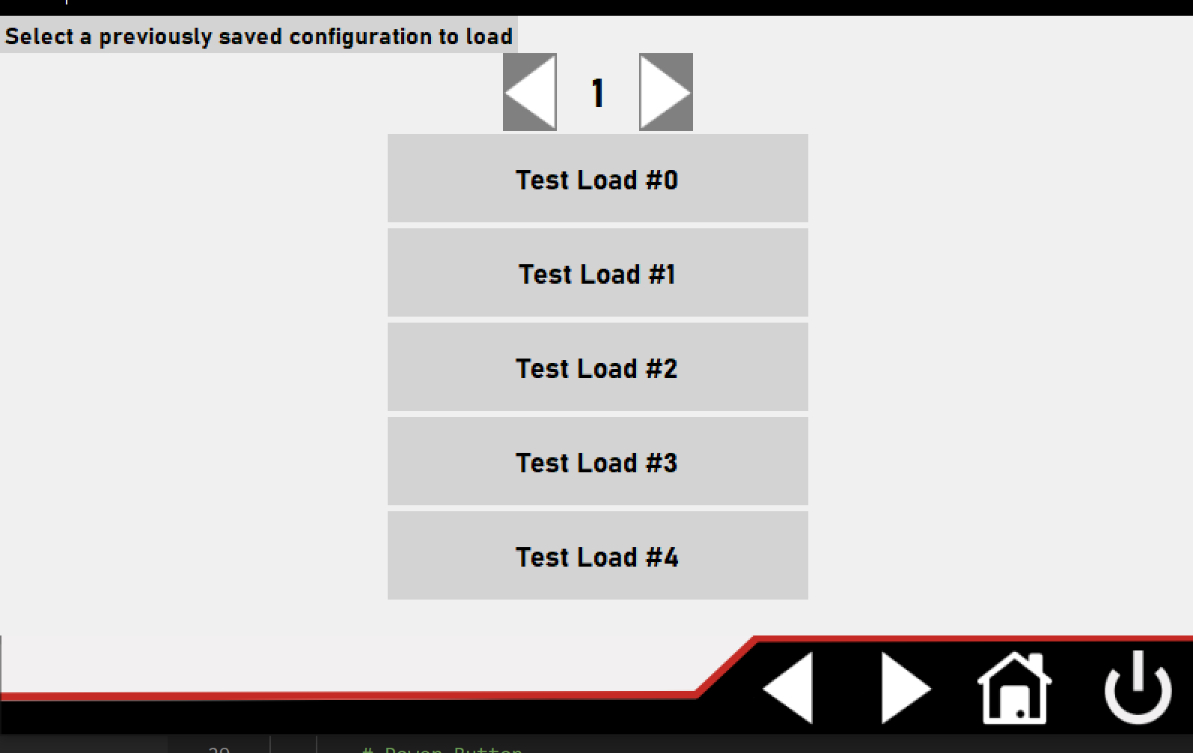
Progress made during the week (Log)
(What I did)

Slide 9
Difficulties encountered during the week
(What I did not do and why)
Did not complete everything for Creedmoor due to time constraints

Slide 10
Goals for this coming week
(Ones that move the project forward the most)
Goal/Task | Stop Date (Est.) | Hours (Est.)
N/A | N/A | N/A
Estimated time needed to work on goals for this coming week (typ. 13 hrs) | N/A

Slide 11
How can we help you achieve your goals?
.

Slide 12
Week 13 (30-Mar to 5-Apr) Dale Andreoli
Goal/Task | % Done | Hours (Act.)
Finish comments and documentation |  | 5
Final report – software part |  | 3
Oral Presentation – create and present |  | 4
Hours on task during the week (On track ≥ 13 / wk) | 12
Total hours on task so far this semester (On track ≥ 163 hrs) | 155

Slide 13
Progress made during the week (Log)
(What I did)
Finished comments and documentation
Created slides for presentation
Gave oral presentation with group
Wrote software part of final documentation report

Slide 14
Difficulties encountered during the week
(What I did not do and why)
Not all backend features were able to be fully implemented such as some of the settings buttons and custom profile features

Slide 15
Week 13 (30-Mar to 5-Apr) John Stinger
Goal/Task | % Done | Hours (Act.)
Hours on task during the week (On track ≥ 13 / wk)
Total hours on task so far this semester (On track ≥ 163 hrs)

Slide 16
Progress made during the week (Log)
(What I did)
For example: Resources found (links, manuals), Designs created, Decisions made and corresponding rational, Photos of prototype progress, etc.

Slide 17
Difficulties encountered during the week
(What I did not do and why)
.

Slide 18
Goals for this coming week
(Ones that move the project forward the most)
Goal/Task | Stop Date (Est.) | Hours (Est.)
Estimated time needed to work on goals for this coming week (typ. 13 hrs)

Slide 19
How can we help you achieve your goals?
.

Slide 20
Week 13 (30-Mar to 5-Apr) Colby Hatton
Goal/Task | % Done | Hours (Act.)
Documentation | 100 | 13
Hours on task during the week (On track ≥ 13 / wk)
Total hours on task so far this semester (On track ≥ 163 hrs)

Slide 21
Progress made during the week (Log)
(What I did)
Documented every step of the hardware design for this semesters senior project.

Slide 22
Difficulties encountered during the week
(What I did not do and why)
Slight confusion in what needs to be done, resulting in some rewriting of parts of the documentation.

Slide 23
Goals for this coming week
(Ones that move the project forward the most)
Goal/Task | Stop Date (Est.) | Hours (Est.)
Graduate! | 4/7 | <5 (Length of the 380 final)
Estimated time needed to work on goals for this coming week (typ. 13 hrs)

Slide 24
How can we help you achieve your goals?
Pizza Party?

